Slide 1
Genomics Working Group

Slide 2
Shameless plug: DPH coding working group
https://massgov-my.sharepoint.com/:x:/g/personal/mary_godec_mass_gov/EWs-bcWyYn1JkZI0FlJkhkQBW0jLQ_WOO5M8TpCeidQrtg?CID=698d6b0a-170b-a877-e9de-e372df9e5d3c
Short-term plans: compile user list of everyone who does code/wants to code more at DPH
Medium-term: establish good coding practices/standards for DPH
Long-term plans – future seminars, workshops, one-on-one help, code review, development opportunities, etc

Slide 3
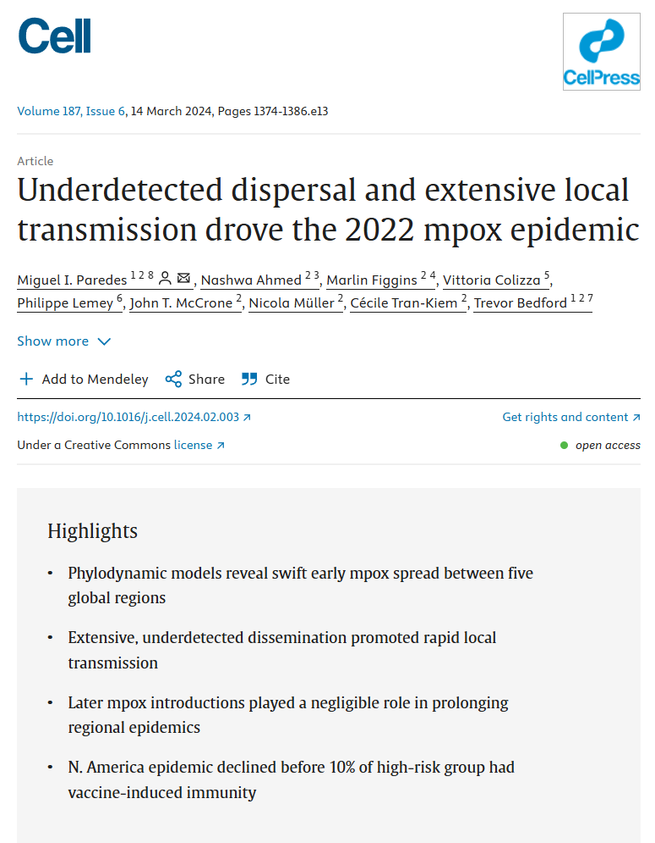
Underdetected dispersal and extensive local transmission drove the 2022 mpox epidemic Paredes, Miguel I. et al. Cell, Volume 187, Issue 6, 1374 - 1386.e13
https://doi.org/10.1016/j.cell.2024.02.003

Slide 4
Overview: Spatially resolved analyses of interventions/spread
Despite the heightened focus on public health surveillance of emerging infections since the start of the SARS-CoV-2 pandemic, MPXV sparked regional epidemics around the world, contributing to a high degree of morbidity among those affected.^{24,27,28}
In this study, we present both a global and regional view of mpox detection, expansion, and containment by jointly analyzing genomic, mobility, and epidemiological data.
We find evidence of rapid spread following initial regional viral seeding events, community transmission prior to detection by local public health surveillance, differential changes in case detection throughout the epidemic, a limited role of viral introductions in prolonging regional epidemics, a large degree of transmission heterogeneity, and limited impact of vaccination campaigns during the early phases of the North American epidemic.

Slide 5
Mpox Clade IIb
Despite double-stranded DNA viruses typically exhibiting a slower evolutionary rate than RNA viruses,²⁹ clade IIb of MPXV has been found to have a significantly faster evolutionary rate since transitioning to sustained human-to-human transmission driven by APOBEC3 editing.³⁰ Although the evolutionary rate of the variola virus (a closely related poxvirus to MPXV) has been previously estimated to be about9×10−6 substitutions per site per year,³¹ we infer the evolutionary rate of the B.1 lineage of MPXV to be 8.41×10−5 (95% HPD 7.71×10−5 to 9.10×10−5) substitutions per site per year or approximately 16.6 substitutions per genome per year (compared with the 1–2 substitutions per genome per year for variola virus). This increased evolutionary rate approaches the rate of many RNA viruses³² and allows for a strong phylogenetic signal (Figures S2 and S5) to analyze epidemic spread and dynamics.

Slide 6
Evaluated interventions to see what affected spread
Mpox in the US and Canada spread predominantly among high-risk MSM populations,⁵⁰ suggesting that the majority of the North American sequences in our study were derived from a similar (but not identical) population as used to estimate vaccine coverage.
Our conclusions are concordant with those from the CDC which also found that Rt fell below one in August 2022 when only about 1.3% of the high-risk population in the US had any vaccine-induced immunity.⁵¹
Similarly, modeling of mpox in Washington, D.C. suggests that behavioral modifications within the MSM community were the main contributing factor to slowing initial mpox spread, but that vaccination campaigns were ultimately needed to definitively curb the local epidemic and prevent future outbreaks.^{52,53} A UK-based modeling study focusing on MSM found that vaccination could not explain the drop in mpox incidence in the region but rather attribute the declining incidence to changes in behavior within the same community.⁵⁴
Together, these findings highlight the significant effect of behavioral change among MSM in curbing the epidemic as well as emphasize the need for prompt public health response in order to maximize the population-level effectiveness of vaccination campaigns.
“An outstanding question raised during the beginning of the mpox epidemic that remains unclear is the potential impact of interventions in preventing and controlling spread.^{40”}
Vaccine campaign/introduction
Travel recommendations/warnings from CDC
Behavioral modifications by MSM community

Slide 7
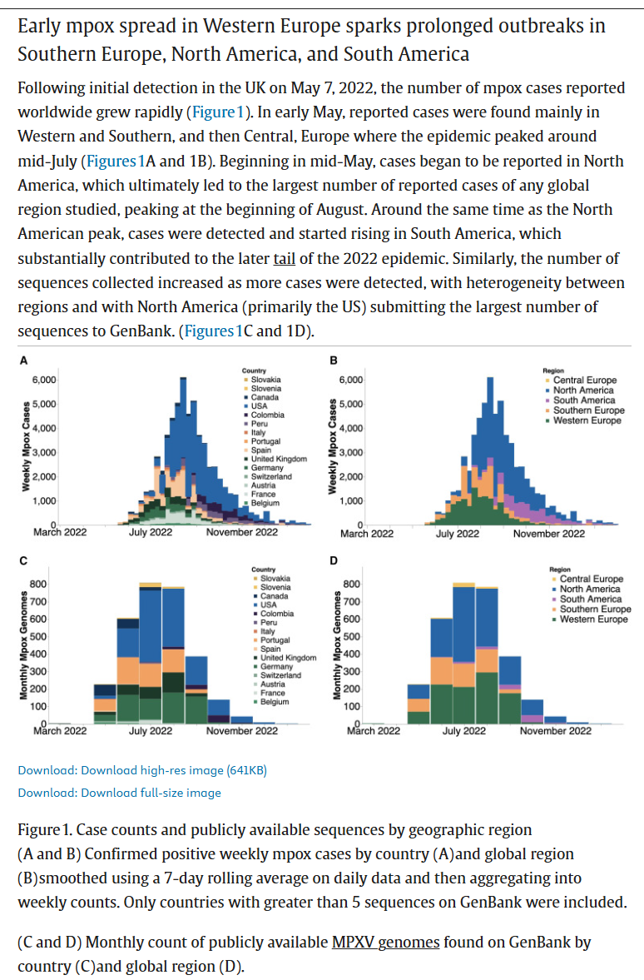
Early undetected spread drove the outbreak

Slide 8
METHODS
In order to analyze within-region transmission dynamics and enhance inference via the joint integration of genomic and epidemiological metadata, we then employed an approximate structured coalescent model (MASCOT) with a generalized linear model (GLM) approach with estimated prevalence and air passenger data as empirical predictors on 587 sequences to infer the effective population size and migration rates within and between each region, respectively (Figure S4A). We also included a predictor for each month to account for potential changes in case detection over time. The included sequences were subsampled with equal temporal weighting to increase representation of undersampled regions such as Central Europe (Figures S1A and S1C; see STAR Methods for more information).
Using a minimum of 5∗107Markov chain Monte Carlo (MCMC) steps to promote convergence, these runtimes translate to 25.5 days of computational demand for DTA and 34.3 days for MASCOT-GLM. As such, we reduced the number of sequences to 587 for MASCOT-GLM to allow for inference within actionable timescales (Figure S1C).
The MASCOT-GLM subsampling scheme is different from that of DTA as the structured coalescent is more robust to differences in sampling across regions and is subsequently informed by regional prevalence.^{17,19}
We used a GLM approach to draw inferential power from relevant predictors and reduce uncertainty relative to inferences using the coalescent alone.

Slide 9
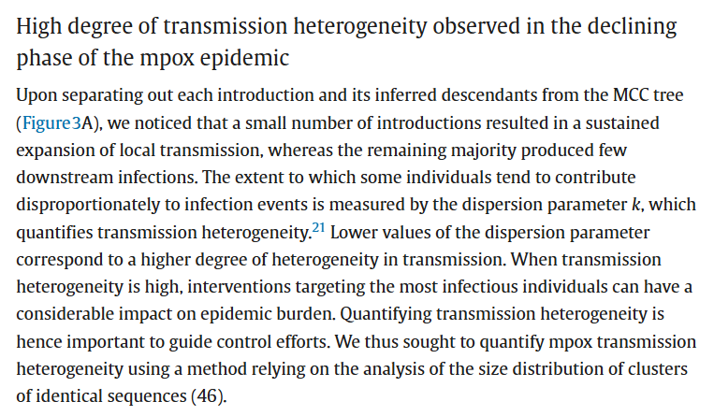
This suggests that transmission heterogeneity alone (without a reproduction number greater than 1) is unlikely to explain the size of the large polytomy observed at the beginning of the epidemic. Overall, the large first polytomy is highly consistent with a reproduction number greater than 1 at the beginning of the mpox outbreak. This aligns with reproduction number estimates obtained from our phylodynamic analysis (Figure 5), which is indicative of mpox spread within the community.

Slide 10
PHYLODYNAMIC INFERENCE CONCLUSIONS
After separating out each introduction and its inferred descendants from the maximum clade credibility (MCC) tree and comparing them to confirmed case counts, we see strong evidence of viral circulation before initial detection in each global region (Figure 3A).
Additionally, we revealed that the largest downstream outbreak clusters arise from introductions prior to detection from public health surveillance, whereas introductions after detection are more likely to be a single case and extinguish quickly (Figure S4B).

Slide 11
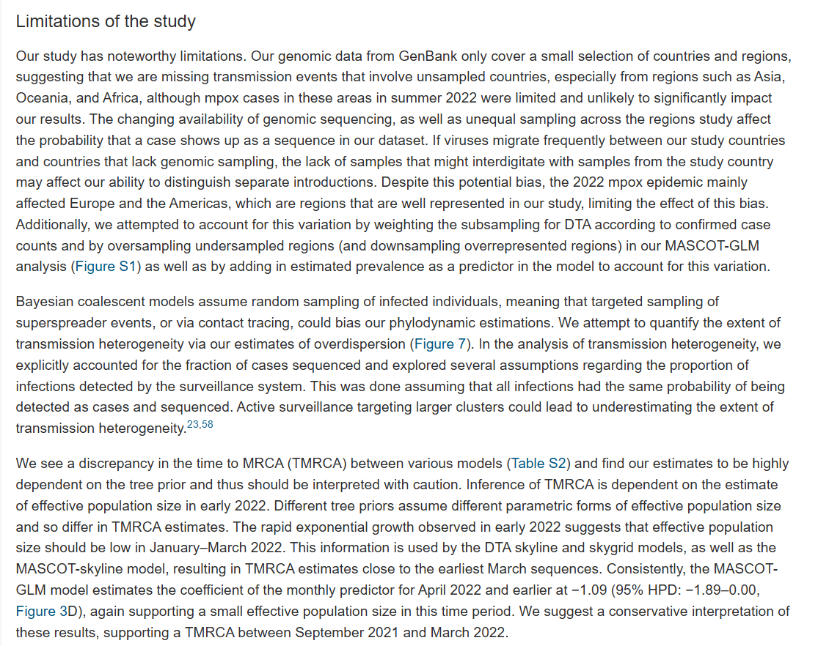

Slide 12
